Slide 1
District 13 Annual Meeting and Orientation 2024
Big Changes!

Slide 2

This years Theme:
Big Changes!

Slide 3
Sections to cover
District Report – JP, Mark, Stacy achievements, setbacks, finances, and more
Little League ADA Report (Mark Dixon, Stacy Ashcroft)
LEAGUE REPORT, What each League Accomplished, FINANCES, NEW BOARD MEMBERS
New Website, Social Media, Email Addresses, and More
New Structure and Boundaries for Little League
New Rules for 2025 – NOT JUST ON THE FIELD
DRAFT DATES, FIRST BOARD MEETING DATES AND LOCATIONS
New Binder Requirements
All-Star Selection, NEW AFFADAVIT TOOLS
District Tournament Site Selection
State Tournament Site Selection (Each district has a State Tournament this year)
Tournament Rules - Early

Slide 4
Sections to cover
How to get MORE and Better VolunteerS
Alcohol, Tobacco, and Firearms
Waivers – Changes in WAIVERS
JDP, Background Checks
Sports Connect – IT IS NOW A REQUIREMENT
Abuse Training , 3rd Party Clinics, Little League Diamond leader League Training
Umpire Clinics, UMPIRE REQUIREMENTS – ABUSE TRAINING, JDP
Scorekeeper Clinics

Slide 5


Slide 6
Accomplishments/Setbacks
District Tournament growing with more teams participating
Conducted Umpire Training
NEED WORK ON DIVISION GROWTH, but had a softball tournament
Levied Assessments and collected funds(THANK YOU!)
Got the required level of participation in ASAP (THANK YOU!)
Saw an increase in player counts in most leagues
New Website for the District, new Facebook
Hardware from the State Tournament
New League in the District! Welcome John!

Slide 7


Slide 8
Accomplishments/Setbacks
Didn’t get all leagues to participate in districts
Did not get coaches training accomplished
Need at least 3 more ADAs (NORTH-BB ADA, SOUTH-BB ADA, Treasurer)

Slide 9
District Goals
More Leagues (especially Northwest of Spokane)
More divisions of play
Better District Tournament (better than last year)
More ADAs – we need help

Slide 10
District Goals
Development of Private fields for Little Leagues – working on that with private land holders for north Spokane.

Slide 11
DA FINANCE Report
Finances –

Slide 12
Your ADA REport
Stacy Ashcroft –President West Plains
Mark Dixon – UIC District 13 – Manager West Plains

Slide 13
Need ADAs
NEED ADAS
  NORTH/SOUTH
  Challenger
  Information
  Treasurer – FUND RAISER

Slide 14
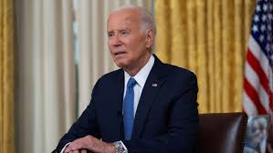

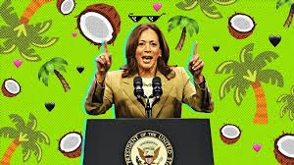
President’s Reports

Slide 15
New Rules for 2025
Mark to Address

Slide 16


Slide 17
Changes in Little League
Central Registration
JDP
New Book requirements for Districts
No Boundaries (Regulation II )
New Rules
Abuse Training Requirements

Slide 18
CENTRAL REGISTRATION
For 2025 ALL PLAYERS MUST BE REGISTERED THROUGH SPORTS CONNECT.
You can use any other program you like for running the league, however all players MUST BE IN SPORTS CONNECT AT REGISTRATION.
ALL Players will have an assigned LL ID. (They already do, but now they are all being connected together with all things little League and that will be visible in the Datacenter)

Slide 19

Sports Connect – now Required
Free but is required for registration.
Automatic interface to LL
Speeds up district prep
Can be done at home in most cases
Integrates with JDP
Accepts payments (fee associated with this)
Creates mailing lists, contact for parents and volunteers
Can have pre-programmed forms, letters, volunteer management
https://www.littleleague.org/partnerships/technology/faqs/

Slide 20
JDP, Rules, Regs, Liability
JDP – each league gets 125 free Lookups!
Yes you have to provide all information requested
Yes you have to do it each year
ANYONE on the board, coaches, team parents, volunteers, UMPIRES, or any person (adult over the age of 18) must have a Background check done
Now through Sports Connect
Liability
https://www.littleleague.org/help-center/j-d-palatine-jdp-quickapp-faqs/

Slide 21


Slide 22
League Development (Regulation II )
Changing Boundaries?
  You Can Adjust Your boundary
  Have to have agreement with adjacent Presidents/Leagues
  DA Approval
  Western Region Approval
  WIlliamsPort Approval

Slide 23
Changing Boundaries
Remember the T-Ball InitiativE
Designed for Schools (targeted to Private Schools)
Only T-Ball at this time
How can this help the local League?
Now can register to 3 years old for LL-TBAll

Slide 24
League Development (regulation II )
No Boundaries?
  Goes Into Effect this year
  Outline of Rules
    Crosses state lines
    Can cross District Lines
    Up to League Age 8
    Can’t switch to be in All Stars at the last minute – has to be in League the whole season (Sibling)
    Sibling Rule has changed – now can be “seconded” to new league with Sibling
    IF SIBLING LEAVES LEAGUE, OLDER SIBLING MUST FOLLOW OR GET CHARTER COMMITTEE WAIVER
    CAN BE iN ANY LEAGUE from age 4-7
    LEAGUE THEY ARE IN WHEN THEY TURN 8 becomes their “HOME” league UNLESS altered by school or residency.
    Changes must be made after age 8 by the charter committee. NOT EVEN WESTERN CAN ADJUST.
    PLAYERS MUST BE IN SPORTS CONNECT FOR REGISTRATION AND FOR RULES TO BE ALLOWED.

Slide 25
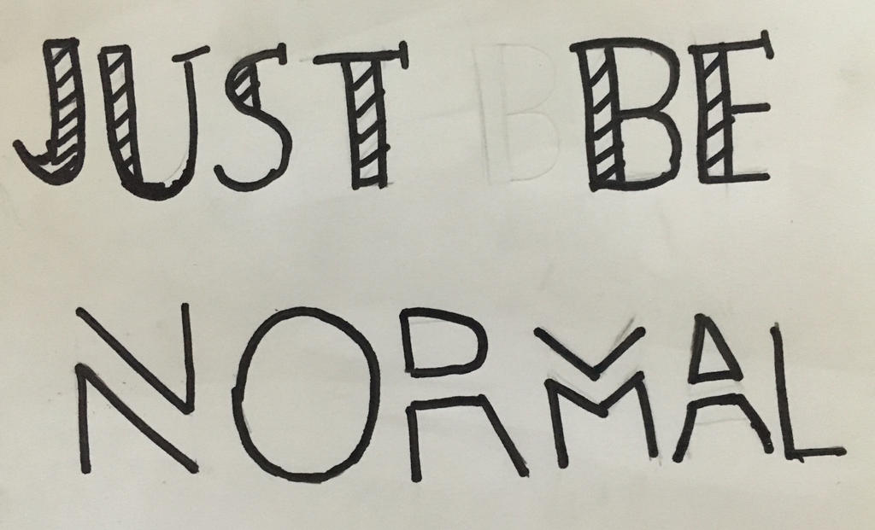
Playing the Season

Slide 26
What we can do this year for regular season play
  Mid Season tournaments
  Travel
  Higher divisions can be ALL “tournament” play
  Special Games – How to play across programs?

Slide 27

Getting Ready For All Stars

Slide 28


All Star Team Selection
  Can begin now at any time after league minimum Game rules have been met
  Get your waivers in BEFORE JUNE 1!!!
  12+ Players on a TEAM (or you need a special waiver)
  NO Waivers needed for Siblings above age 7 so long as they played all season in league.
  Multiple teams allowed under 10-11.

Slide 29
District Tournament
Adding Divisions
Multiple Teams in a division
Location
Date
Tournament Director
MAKE IT SPECIAL!
PINS/AWARDS
Basic Guidelines
  Play all divisions at one location if possible (softball?)
  Have plenty of volunteers
  Concessions
  Umpires (at least 2 per game)
  Start NOW!

Slide 30
State Tournament - DISTRICT 13!
State Level Tournament 10-11 Baseball (July 19-26)
Pageantry
OFFICIAL OFFICIAL OFFICIAL
Team Parade, Special events, city involvement
See Newspaper, get the word out, publicity
Tournament Packets
Field Quality, Preparation
Equipment, baseballs
Coordinate with State UIC
Start now

Slide 31
WhaT we are NOT going to do for State this year!!!
Sports Connect hELPS this year!
Late books
Late waivers
“Working the system” to squeeze a player in – straight up!
NO sponsors on jerseys
No advance without play

Slide 32
Alcohol, Tobacco, firearms
Somethings are getting to be a problem – examples
What is “legal”, what is “Illegal”? Know your city/county/state ordinances
Little League Policy states:
Example for the kids
Inspecting Coolers, totes, bags, etc.

Slide 33


Slide 34
What can we do better for District Tournament play
More Umpires
Concessions
Books
Field prep
Publicity
Equipment (Baseballs, dugouts, scoreboards, Pa system)

Slide 35
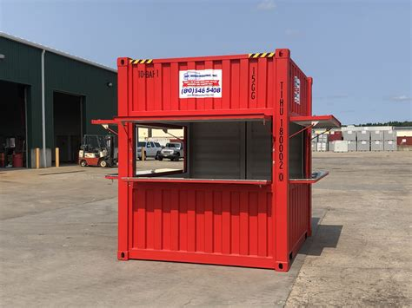
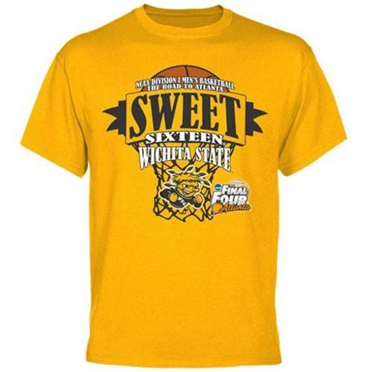
What can we do better for District Tournament play – Be creative!
50/50
https://www.jerseywatch.com/blog/youth-sports-fundraising-ideas

Slide 36
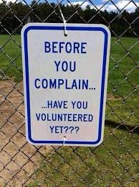

Slide 37
How to get MORE and better VOLUNTEERS START NOW!!!
Build a “TEAM” (Start with meet the team night)
Begin recruiting now
Use EMAIL LISTS TO YOUR FAMILIES TO RECRUIT!
Have printed JOB descriptions for the roles you need
Reward volunteers (T-Shirts, plaques, pins, mentions at team night, free hotdogs)
Have a volunteer coordinator on your board
Seek inside of Little league and OUTside of little league, enjoin the community, make them part of the team (churches, civic groups, fraternal organizations)
Registration requirement!

Slide 38
Start Now – Set expectations
Set expectations Starting now, have standards
  Travel
  Participation
  Rules
  Volunteerism
  Board accountability, work, effort, standards
  Teams, draft, rules rules rules
  Communicate often, clearly, obviously
  Email, facebook, print, flyers

Slide 39

Better Board Performance

Slide 40
Build a better board
Be selective about who is on the board
You want workers, not watchers
Board size? Good question
Accountability, cooperation, collaboration, team
Get rid of bad board members – what makes a “bad” board member?
Know your charter, constitution, by laws, laws, policy, procedure
Little league focused, can’t have involvement in travel teams
Get a mix of baseball and “non-baseball” people on the board, people from the community
Start now!

Slide 41

League Expansion?

Slide 42
Why Do League Expansion?
Serve More Families
Expand your volunteer base
Give more kids the possibility of playing
Access to more resources
Serve more communities
Remember you are part of a SERVICE ORGANIZATION!

Slide 43
Strategies for expanding your league
  Know your population (schools, city, county, league boundary)
  An average is 20-25% of the kids in the schools in your area
  Cater to all ages possible
  Watch the “Ladder” of divisions – have a rationale why one division is stretched, while others are shrunk as an example.
  Know your playing resources (fields, equipment, volunteers)
  Contact your Athletic Directors, PE coaches, principals, school board
  Easy adds: Challenger, Juniors, Seniors, Softball – buy why?
  Give the players goals – “District All-Stars”, state, player of the week, etc.
  Get the entire community involved. Make Little League a “thing”
  Focus on T-Ball and work up – 100% subsidized, daycares, private school program,
  Work with businesses to develop scholarships for economically burdened families
  Publicize little league (PSAs, print, stories in the local paper, TV, facebook, tiktok, twitter, Instagram) – social media / information board member
  START NOW!

Slide 44
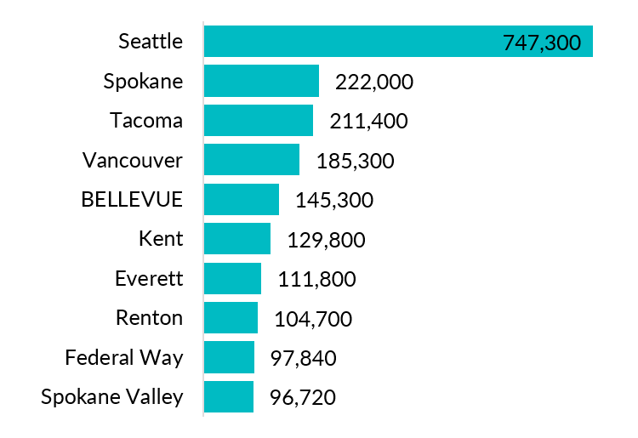
Strategies for expanding your league
  Example https://www.univstats.com/k-12/washington/spokane-public-schools/
Spokane County 539,000
Lincoln 11, 000
Ferry 7,200
Grant 100,000
Pend Oreille 13,800
Stevens 46,445
Okanagon 41,000
Or about 758,700 population !!!

Slide 45
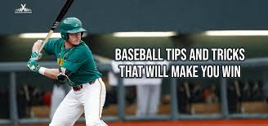
Tips and Tricks

Slide 46
Combined Teams
What is a “combined” team?
When to register/charter
Waivers and approvals
District Play – good idea!
Can you combine teams early and play regular season?

Slide 47
District Teams
When to charter a district team
Can they travel?
Tournament play?
All Star Play?
Rules?
  My Rule – have to donate an ADA!
What divisions?

Slide 48
Waivers
What are “waivers”?
Don’t bring me a waiver “late”
Don’t bring me a Waiver “malformed”
Don’t try to sneak in a kid
District due before June 1
  https://www.littleleague.org/university/articles/types-of-waivers/

Slide 49
Playing other programs
Needs to be approved
Must have insurance waiver/rider and must be mutual
Must be in your same Division/League age
Should not cost the parents extra
Tournaments can be played

Slide 50
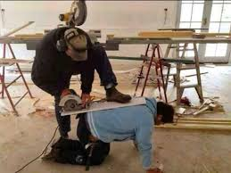
Safety

Slide 51
ASAP – Safety Plan
Have to submit it every year
If we get it all in before April 1, the DISTRICT gets a credit to their account of $600!
Should be reviewed with all managers, concessions workers, and board members
DA has Templates
We met our goals last year!!
Get it done by March 15!
Concussion Protocol

Slide 52

Some extra Bonus material

Slide 53
Coaching Clinics
Do we want coaching clinics?
  When?
  Where?
  What Divisions
3rd Party Clinics – Mariners, Former MLB Clinics
PCA certifications – Positive Coaching alliance - https://www.littleleague.org/partnerships/pca/
Diamond LeaDer Training https://www.littleleague.org/news/little-league-announces-its-diamond-leader-training-program-a-free-coaching-education-tool-focused-on-social-and-emotional-learning/

Slide 54
Umpire Clinics – Mark Dixon
Who wants Umpire clinics?
  When?
  Where?
State Clinics – State UIC – Mar 1, 2025
Regional – Western Region Clinics
High School Student – project requirements

Slide 55
Scorekeeper Clinics
Do we want Scorekeeper clinics?
  When?
  Where?

Slide 56
Discussion
Discussion

Slide 57
And Finally ….
Remember – Little League is successful because of good boards, good volunteers, energy, and a focus on the player and their families. Make it a community, make is special, make it fun, and teach the kids how to be better people, not just better players.

