Slide 1
District 13 Annual Meeting and Orientation Meeting 2021
Making Your League Better!

Slide 2
Sections to cover
General Introductions
State UIC – Dennis Williams
League Development – Brennan Moore Touchet Valley Little League
Combined Teams/District Teams
Marketing/Promoting Your League
Safety (ASAP)
Training For Board Positions, Managers, Coaches, Concessions,
District Goals

Slide 3
Introductions
Dennis Williams State UIC
Brennan Moore President of Touchet Valley LL
Stacy AshCroft ADA
You All

Slide 4
State UIC – Dennis Williams
the role of the State Umpire group/association
how to get umpires better trained
How to motivate local umpires to be more involved in Districts etc.
How to recruit better/more/other umpires (where to find them?)
What umpiring Little League does for the umpire – of what benefit is it to the umpire?
How to retain umpires year in and year out
Other Ideas

Slide 5
Paying Umpires?
Generally a bad idea – for lots of reasons
However it is possible
  Proper insurance (little league does not provide)
  State mandated coverages
  Withholdings or 1099 – must be contract based if 1099
  Liability questions
  Workman’s Comp
Board loses protections if done improperly

Slide 6
Umpire Training Day?
Do we want to have an Umpire Training day?
(Feb/March 2022)

Slide 7
NEED ADAs
Several Needed
UIC – District (must be 18y.o. or older)
Safety
Information
Pre-Congress, Congress, State Meetings, Regional meetings, Williamsport

Slide 8
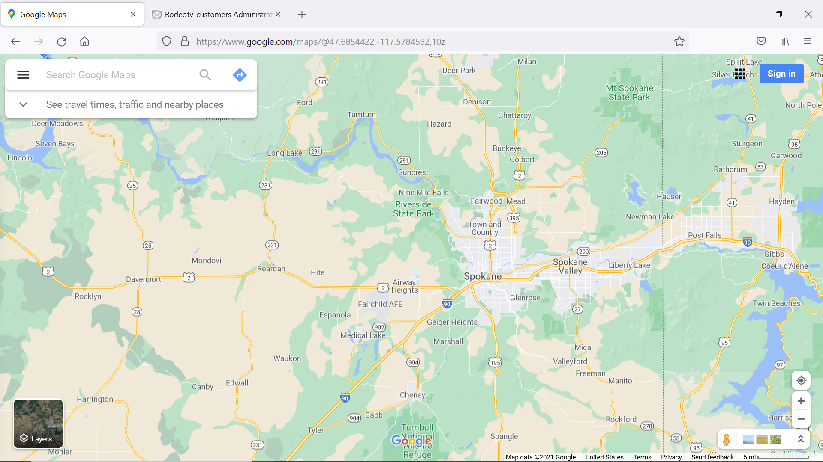
Where we cover
573,000 in Spokane, not counting all bedroom communities
About 30,000 students in Spokane Alone

Slide 9
Potential Player Population
Spokane > 30,000
Spokane Valley ~3000
Cheney ~5000
Deer Park ~3000
Liberty lake ~1300
Newport ~1200 (plus others)
Davenport – MAP IS MISSING!
Not counting PRIVATE SCHOOLS (~6000 students in all 28 private schools in the area)
    Statistics from https://nces.ed.gov

Slide 10
League Development
Brennen Moore Touchet Valley Little League – First Question, would you travel to another district to help other leagues?

Slide 11
League Development
New T-Ball InitiativE
Designed for Schools (targeted to Private Schools)
Only T-Ball at this time
How can this help the local League?

Slide 12
League Development
League Development Resources
Just search “League Resources”

Slide 13
League Development
Towns that have inquired about starting Leagues
  Omak
  Colville
  Republic
  Chelan
  Moses Lake
  Mead
  Redrawing League Boundary southern edge of District 13

Slide 14
Existing League Development
It’s about Communication!
  Promotion
  District Level Advertising
  LL Resources (PSAs, Ads, League Finder, Inquiries)
  Schools
  ListServer
MEET THE TEAM NIGHT
  Make it a surprise ( Don’t talk about the draft )
  Equipment Swap
  Give Aways

Slide 15
Existing League Development
Adding Divisions
Intermediate
Softball
Juniors
Seniors

Slide 16
Existing League Development
Intermediate
Ages 11-13
Lead oFf Steal
Pick Off Moves
Balk
Longer Field
Longer base Paths
District, State, Regional, World Series
Good for places where Jr. High / Middle School Baseball has been Cancelled

Slide 17
Existing League Development
Softball
T-Ball through Seniors
Good Alternative to ASA, AAU, and Travel Teams
Field Complexes where they can play with Baseball Works Well
District, State, Regional, World Series

Slide 18
Existing League Development
Juniors
  60-90 Mound/Base Paths
  Fields are harder, but there are some around – Schools, Municipal, Private Schools
  Good for High School Support and JR. High/Middle School
  Age 13-14

Slide 19
Existing League Development
Seniors
  60-90 Mound / Base Paths
  High School Supported
  Same Fields as Juniors
  District/State/Regional/World Series

Slide 20
League Development
How to counter Travel Ball/Elite Team DraW
  Expensive – little League is very affordable
  Little League is More about “Team play”
  Little League is More about Community
  Everyone gets to play in Little League
  Little League is Better Organized
  Little League has a Better “Post Season”
  NONE of these “Elite” teams can hold a candle to a state level team or better

Slide 21
Existing League Development
CombineD Teams as a way to combat Travel Teams
District Teams as a Way to combat Travel Teams
Everyone, Every League Faces pressures from competing Sports programs. KNOW THE VALUE OF little league!

Slide 22
Existing League Development
Funding
Revenue vs. UBI How to generate it
  Concession sales
  “gear” sales
  Fees
  Grants
  Field Rentals (have a sign up that says “Join Little League today and Play better”

Slide 23
Existing League Development
Funding – GET A GRANT WRITER!
  RCO Grants – up to $500K or more https://rco.wa.gov/
  Crowd Sourcing https://www.littleleague.org/playing-rules/position-policy-statements/crowdfunding-or-other-online-fundraising/
  Ex-Mrs. Bezos, Microsoft, Boeing
  DA occasionally knows of where to get funding
  LOCAL grant funding (just watch PBS!)
  Little League Programs (Go To LITTLE LEAGUE WEBSITE) https://www.littleleague.org/grant-resources/
  Learn to use “matching Grants”

Slide 24
Existing League Development
CoACHES Training (things I saw this season)
  Poor lower division training (T-Ball, Coach Pitch, minors)
  Poor Pitching Training
  Lack of knowledge of fundamentals of Baseball
  Lack of Knowledge of rules
  Poor safety training
  Disregard or ignorance of ASAP guidelines and Little League Policy

Slide 25
Existing League Development
Coaching Clinics?
  How about Feb/Mar?
  Spend 2 hours on a Saturday PER DIVISION (start at 8:30, then 11:00, 1:30, 4:00) Up through intermediate division coaching trainig?

Slide 26
Play Modifications
District Team
Combined team
  Benefits – players can play MORE in other divisions, for other leagueS
  Leagues that may not have enough players to field a couple of teams for intra-league play can create “combined” teams with other leagues to get their players back in the game.
Interleague and Interdistrict play

Slide 27
ASAP – Get it done early!
There are templates available – use the one from Last Year if it was approved
Review with Managers, Concession Staff, Board
If it gets submitted and approved by April 1, the District will get a $600 credit!

Slide 28
District Goals
More Leagues

Slide 29
District Goals
Umpire recruitment And Training

Slide 30
District Goals
Coaches training

Slide 31
District Goals
District and State Participation

Slide 32
District Goals
Development of Private fields for Little Leagues

Slide 33
Discussion
Discussion

Slide 34
And Finally ….
Remember – Little League is successful because of good boards, good volunteers, energy, and a focus on the player and their families. Make it a community, make is special, make it fun, and teach the kids how to be better people, not just better players.

